Slide 1
Network Traffic Botnet Classification
Kate Stadelman

Slide 2
Agenda
Introduction
Data
Random Forest
References

Slide 3
Research Question
Introduction
Network Traffic Anomaly Detection
Can we detect Botnet activity
among normal network traffic?

Slide 4
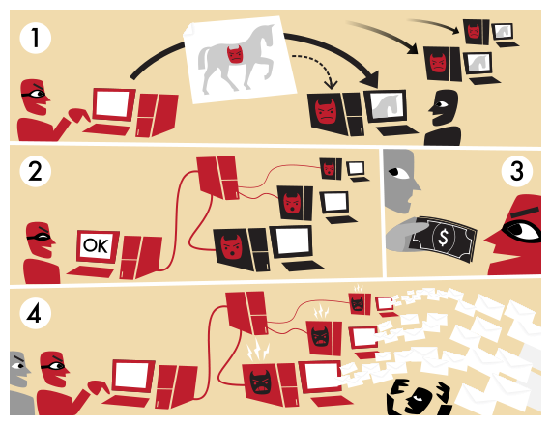
Botnet Definition
Introduction
What is a Botnet?
Network of Hijacked Devices
Most are Home Computers
Used for Cyber-Crime
Distributed Denial-of-Service (DDoS)
Stealing Personal Data
Sending Spam
Bitcoin Mining
“Botnet” by Tom-b – Own work.
Licensed under CC BY-SA 3.0 via Wikimedia Commons.

Slide 5
Motivation
Introduction
Cyber Security: A Primary Concern for US Businesses
“71% of US CEOs said they are ‘extremely concerned’ about cyber threats -- ahead of pandemics and other health crises (46%)”
— PwC’s 2021 CEO Survey
The average cost of a Distributed Denial-of-Service (DDoS) attack is
$123K for small business and $2.3M for enterprises.
— Kaspersky Lab’s IT Security Risks Survey 2017

Slide 6
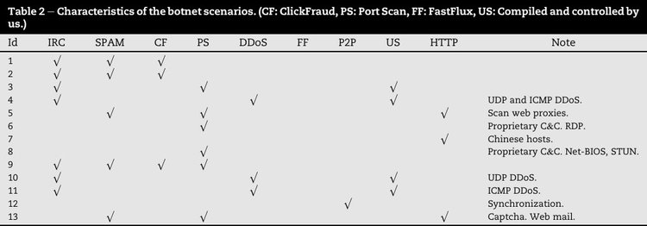
Data Set
Data
“The CTU-13 is a dataset of botnet traffic that was captured in the
CTU University, Czech Republic, in 2011.”¹
This research project utilizes CTU-13 #10.

Slide 7
Data Description & Preparation
Data
Reduced Sample Period
5 Hours to 1 Hours
1.3M to 208K Records
Maintained ~8% Total Botnet Flows
Removed Sparse Fields
Hops & Time-to-Live
Randomly Split Sample
75% Training & 25% Validation
Selected Features
Highlighted in Blue
Data Fields | Mail Delivery Analogy
Traffic Label | Mail Item Name
Start Time | Time First Package Sent
Last Time | Time Last Package Sent
IP Address* | Office Building Address
Protocol* | FedEx/UPS/USPS
Port* | Mailroom Slot
Duration* | Total Transit Time
Packets* | Number of Packages
Bytes* | Combined Size of Packages
Rate* | Package Speed in Transit
*Both Source & Destination

Slide 8
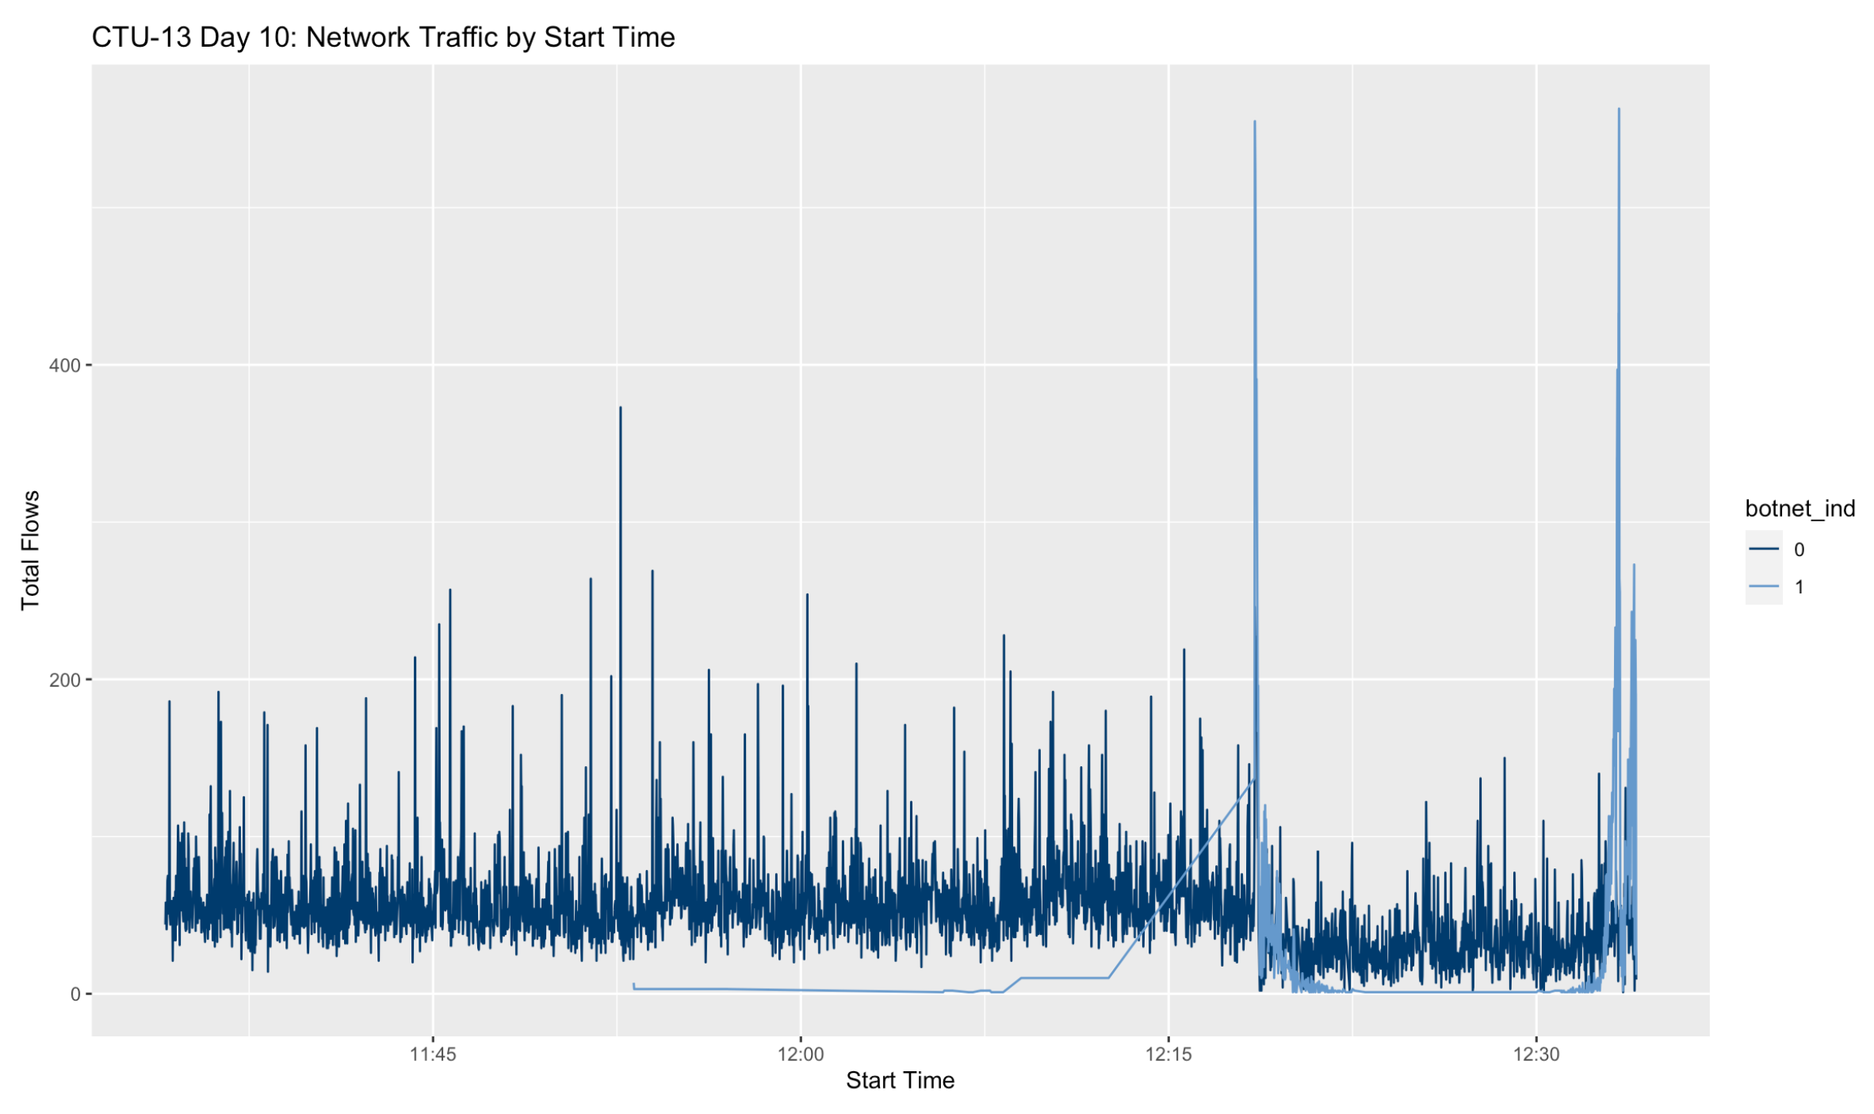
Data Visualization
Data
Total Flows
Type | Flows | %
Normal | 208,360 | 92.5%
Botnet | 16,810 | 7.5%

Slide 9
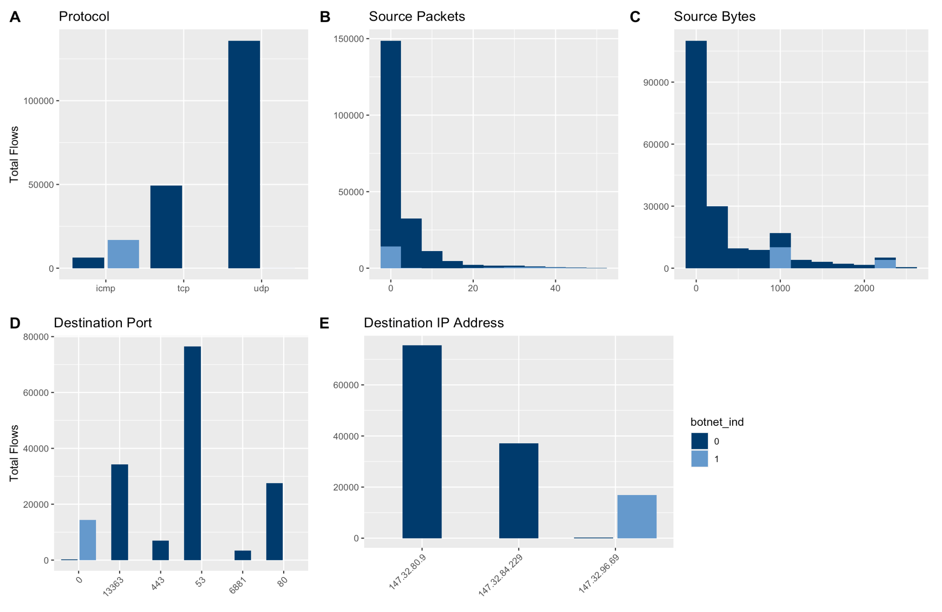
Data Visualization
Data

Slide 10
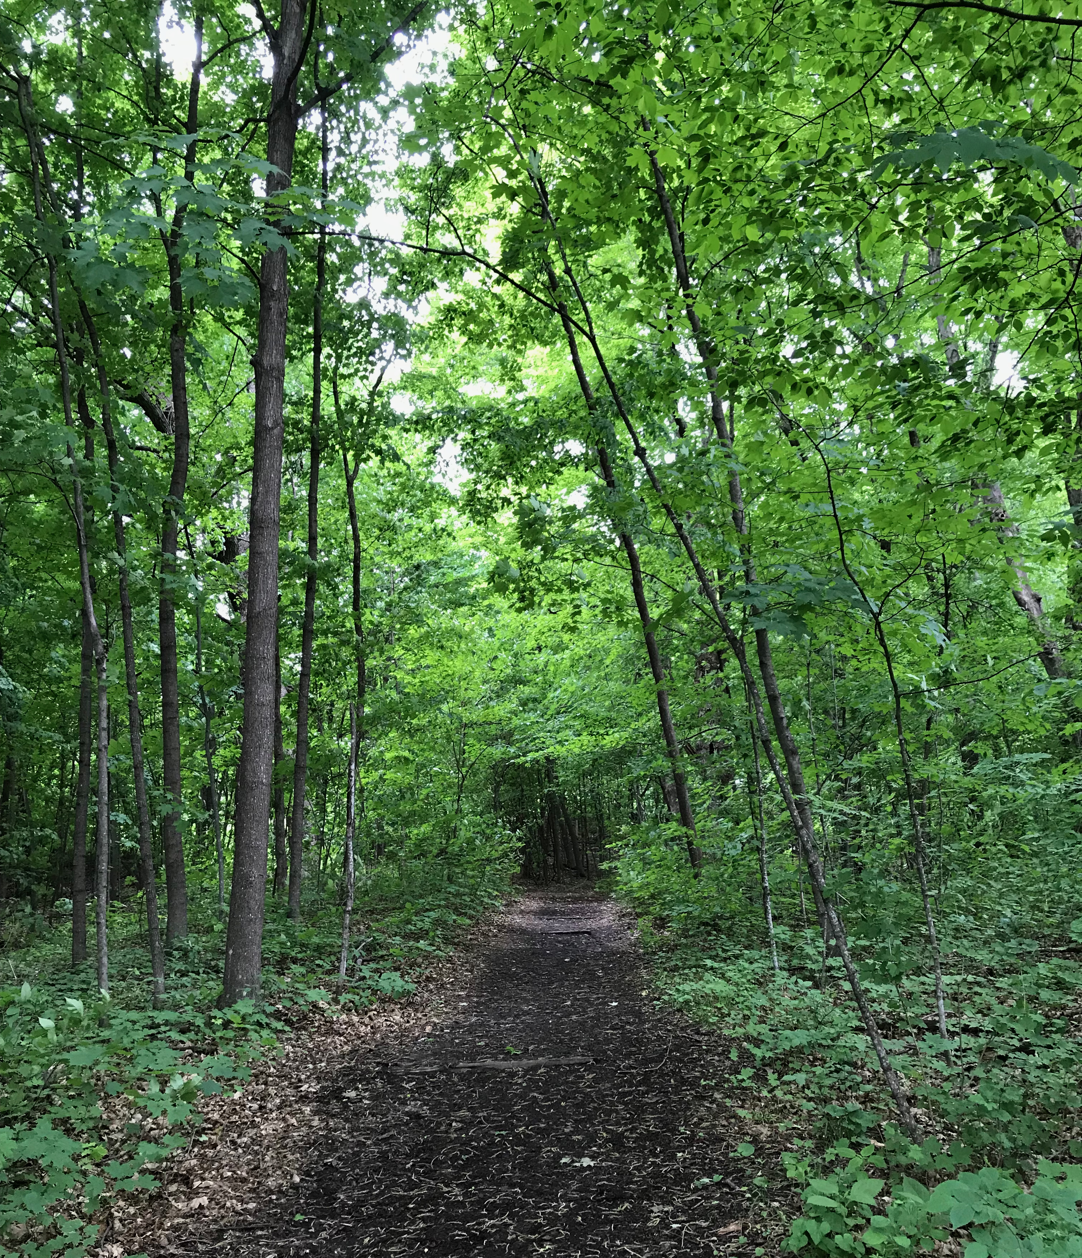
Model Overview & Description
Random Forest
First Proposed by Tim Kam Ho in 1995
Ensemble Machine Learning Algorithm
Performs Classification & Regression Tasks
Handles Large Data Sets with High Dimensionality
Bagging (Bootstrapping Aggregation)

Slide 11

Model Overview & Description
Random Forest

Slide 12
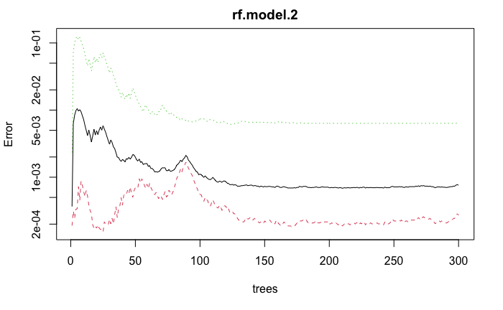
Model Training
Random Forest
Confusion Matrix
Parameters
Variables @ Each Split: 5
Trees: 300
Max Nodes: 5
 | R. Normal | R. Botnet | Error
P. Normal | 143,623 | 39 | 2.71e-4
P. Botnet | 80 | 12,528 | 6.34e-3

Slide 13
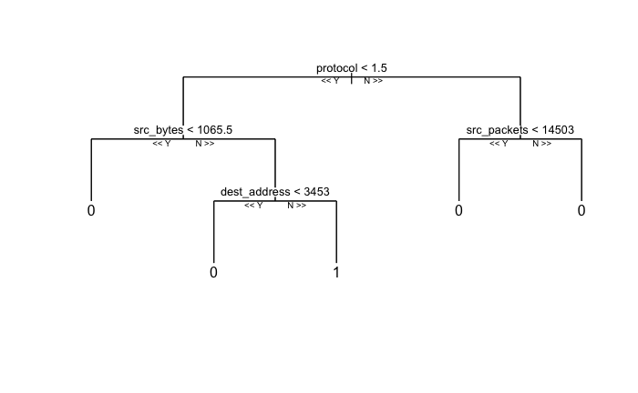
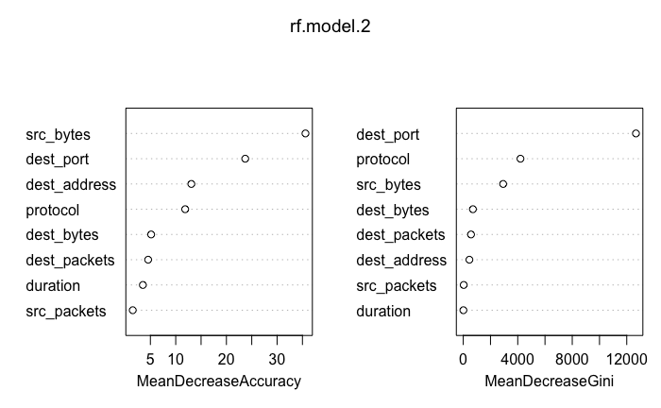
Model Diagram & Important Features
Random Forest

Slide 14
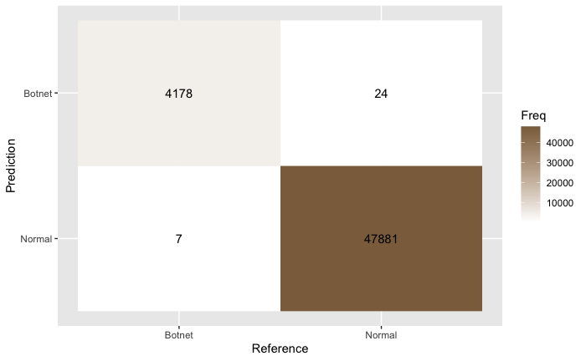
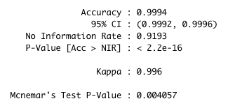
Model Validation
Random Forest
Confusion Matrix

Slide 15
Discussion
Q & A

Slide 16
References
Farnaaz, N. & Jabbar, M. A. (2016). Random Forest Modeling for Network Intrusion Detection System. Procedia Computer Science 89, (213–217). https://www.sciencedirect.com/science/article/pii/S1877050916311127
Garcia, S., Grill, M., Stiborek, J., & Zunino, A. (2014). An empirical comparison of botnet detection methods. Computers and Security Journal, Elsevier, 45, (100–123). http://dx.doi.org/10.1016/j.cose.2014.05.011
Marchette, D. (1999, April, 9–12). A Statistical Method for Profiling Network Traffic. Proceedings of the Workshop on Intrusion Detection and Network Monitoring, Santa Clara, California. https://www.usenix.org/conference/id-99/statistical-method-profiling-network-traffic

